Slide 1
i. Frontend (HTML, CSS, JAVAScript) ii. Arrays, 2d Arrays, sorting

Slide 2
Let’s Begin FROntend from scratch
What is HTML, CSS, JavaScript?
Learn HTML
Learn CSS
Learn JavaScript
Test & Implement your knowledge

Slide 3
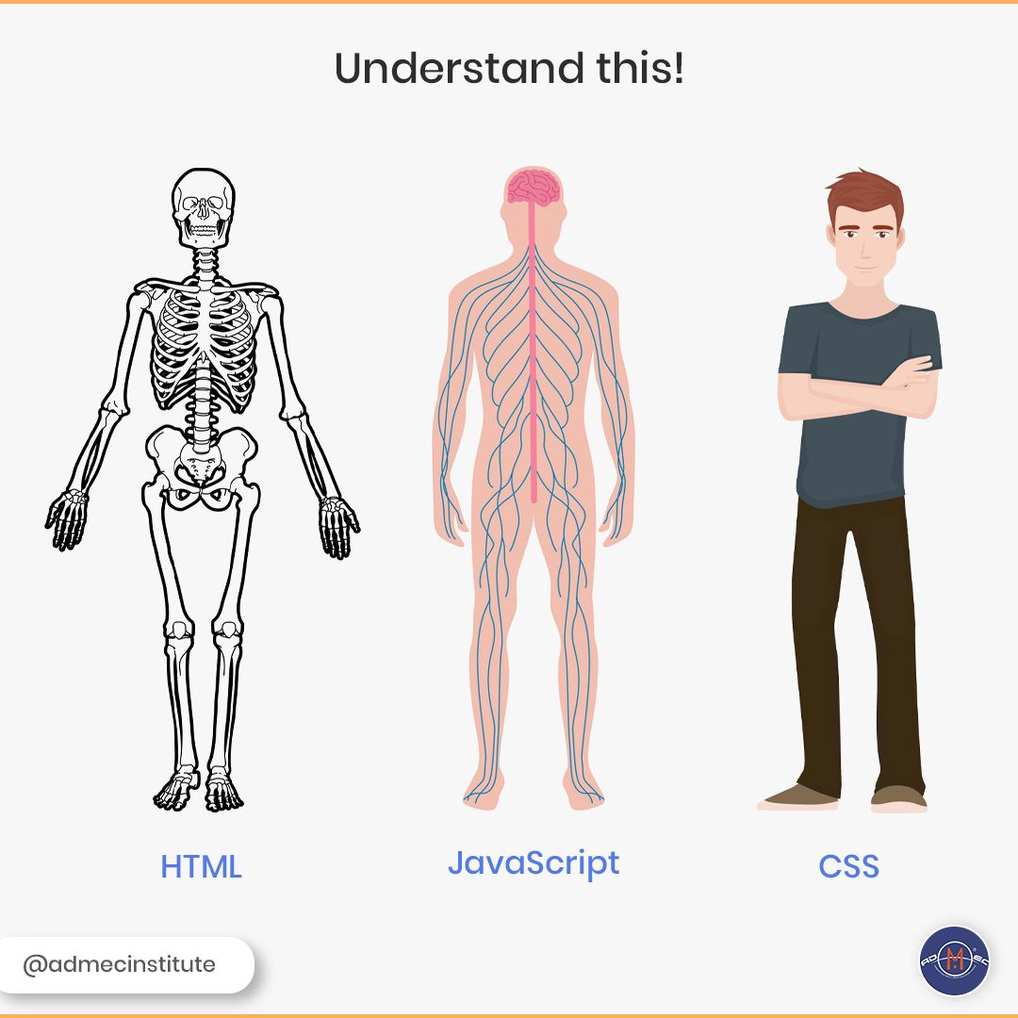
What is html, css, javascript?
HTML, CSS, JavaScript are the building blocks to launch your career into web development.
In a website the structure is given by HTML, the look or styles are given by CSS, and the functionality are added by JavaScript. Together they make the frontend part of the website.
There are various other technologies like react which are front end frameworks , but having some knowledge of HTML, CSS, JavaScript is always required.

Slide 4
HTML
Html is written inside tags. Different tags have different functionality.
Know the code flow in an html document. Get familiar with mostly used tags.
Following are must to know tags in html :
<head> , <body>
<h1>, <h2>, <a> , <p> , <div>, <img>, <br>, <button> , <pre>
Follow these Free Resources to begin learning
https://www.youtube.com/playlist?list=PLC3y8-rFHvwiLG5IsOAxDkacPGPVYZlOT (Follow this playlist to get started with html css in a guided way)
https://www.w3schools.com/html/default.asp (Don’t forget to check out w3 schools)

Slide 5
CSS
CSS is used to style the html document.
Learn by adding css attributed to the created html tags . You may follow this video https://www.youtube.com/watch?v=1Rs2ND1ryYc&ab_channel=freeCodeCamp.org
CSS is the most important part in front-end because this is what troubles the most, but don’t worry, remember you can always google things up (There is chance that solution to what you are looking always exists somewhere in the web :) .
Bootstrap : - We generally don’t write the css from scratch instead include bootstrap in our document and use the pre written code to load components.(*link to get going with bootstrap)
Follow these Free Resources to begin learning :
https://www.youtube.com/playlist?list=PLC3y8-rFHvwiLG5IsOAxDkacPGPVYZlOT (Follow this playlist to get started with html css in a guided way)
https://www.w3schools.com/css/ (Don’t forget to check out w3 schools)
The bootstrap documentation is enough to include it in your project , but still if you want you are free to lookup on Youtube.

Slide 6
Javascript
JavaScript is the world’s most popular language. JavaScript add functionality to your website.
Get to know JavaScript HTML DOM (https://www.w3schools.com/js/js_htmldom.asp).
Free Resources :
https://www.youtube.com/playlist?list=PLC3y8-rFHvwhI0V5mE9Vu6Nm-nap8EcjV (Follow this playlist to learn beginner level JavaScript)
https://www.w3schools.com/js/default.asp (W3schools, must check out this)
https://www.youtube.com/watch?v=ZvbzSrg0afE&list=PLlasXeu85E9cQ32gLCvAvr9vNaUccPVNP&index=4 (Intermediate level JavaScript)
Pro tip- You can make use of git hub student developer pack to get free subscription of top educating websites like Frontend Masters and do great courses for free.

Slide 7
Test and Implement
In order to test a candidates level of grasp in front end he/she can be asked to present his projects and also explain them in short.
The present assignment which I am doing is another way of testing the skills. To see how good one has understood is to ask him teach what he/she has understood.
One more way can be implement what you have learned this way you can test how much you have understood.
Do projects: https://www.youtube.com/watch?v=GeykycZ4Ixs&ab_channel=CodeWithHarry

Slide 8
Let’s Begin ARRAYS from scratch
What is an Array?
What is a 2D Array?
Array Sorting
Test & Implement your knowledge

Slide 9
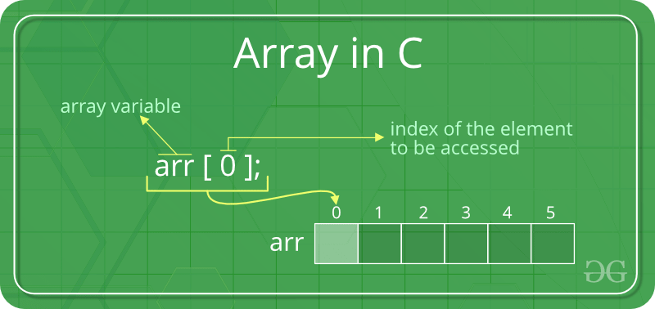
Arrays
It can be defined as collection of similar items stored in contiguous memory location.
Visit for detailed learning https://www.geeksforgeeks.org/introduction-to-arrays/
Indexing from
0 to capacity-1.
Arrays allow random access to elements using array indexes. This makes accessing elements by position in O(1). Arrays have better cache locality that makes a pretty big difference in performance. (next element required is located nearby) | Once you have declared the array you can’t change its size because of static memory allocation. Here Insertion(s) and deletion(s) are difficult as the elements are stored in consecutive memory locations and the shifting operation is costly too.

Slide 10
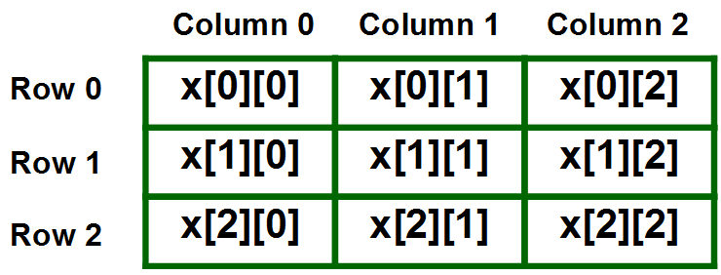
2d Arrays
An array of one dimensional array is 2 dimensional array, the simplest of multidimensional arrays.
In order for simpler understanding we visualize it as N X N square matrix but in memory it is stored in continuous location.
Visit for detailed learning : https://www.geeksforgeeks.org/multidimensional-arrays-c-cpp/

Slide 11
Sorting Arrays
Sorting is re-arranging the array elements in ascending or descending order according to the requirement.
There are various sorting algorithms used, you can learn it from : https://www.geeksforgeeks.org/sorting-algorithms/
Most popular sorting algorithms one must know are Bubble Sort , Selection sort , Insertion sort , Merge Sort , Quick Sort , Heap Sort , Counting Sort.
There are various time and space complexities associated with these sorting algorithms so one should use them accordingly. https://www.geeksforgeeks.org/time-complexities-of-all-sorting-algorithms/

Slide 12
Test and Implement
Practicing what you have learned is must. https://practice.geeksforgeeks.org/explore/?category%5B%5D=Arrays&page=1&category%5B%5D=Arrays
Practice various traversals like diagonal (spiral traversal , boundary traversal in 2d array).
In-order to test a candidate, question based on arrays can be asked like what is the time complexity of insert and why it is O(n) , coding problems can be asked. (*link)

